Slide 1

Choosing Better Open Source Code
Lessons from the real world
Michaela Demeter
Security Researcher

Slide 2
How well do you know what’s inside your projects?

Slide 3
As a Security Professional you are expected to know what is in your product
Notes:
Sometimes as a security professional you are not aware of a product until it is ready for release and the team contacts you to say they have an issue. Today teams are beginning to be more proactive instead of reactive so hopefully you are brought in early during architecture discussions.

Slide 4
There’s a big difference between good, community-supported open source software and random code found on the internet.
Notes:
I am leaving these original notes from one of my co-workers in because they are exactly what I was stating in the previous slide notes.
"So, let’s be honest, I thought the team at SeCoE that made this policy change was making a mistake. I mean, this was better than doing full SDL on every single bit of code you used, but surely our engineers were good enough at determining what packages were good and which were terrible? Turns out, no, we’re not."

Slide 5
“I have been involved in examining open source projects and third party components for 'known good' development practices.”
Notes:
I originally was a Security Champion in Intel's Open Source Technology Center (OTC). This was a full time job and when the Security Development Lifecycle was expanded to cover all software at Intel, well let's say it was a nightmare. No one truly understood how much open source software was being used but our small team understood all to well. I moved to the Corporate team responsible for governance, training and SDL. This is important because in order to work across Business Units you need to have management backing.

Slide 6
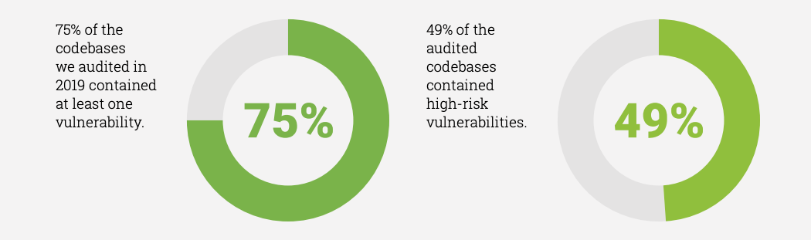
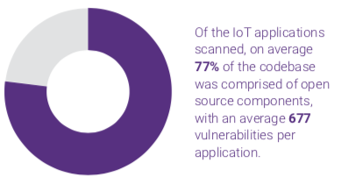
Yikes
Source:
2020 & 2018 Open Source Security and Risk Analysis
Synopsys Center for Open Source Research & Innovation
Notes:
This is absolutely not good news at all. In fact it shows that as more open source software is used we are getting worse at securing it.
Source: 2020 Open Source Security and Risk Analysis
Synopsys Center for Open Source Research & Innovation

Slide 7
I want to enable you to ship more secure better quality open source software.
Notes:
By giving you some real world examples and a few tools to use I hope to help instill a security first attitude. This enables you to make good choice up front rather than reacting to issues after releasing the software.

Slide 8
How do I choose good Open Source Packages?
Notes:
I am not here to tell you how to choose open source. Just here to help you make better choices. So I will explain my process for looking at packages because "GOOD" is such a subjective term.

Slide 9
How do I choose Secure Open Source Packages?
`
Notes:
I will be the first to say you can not ever be sure the open source software you have chosen to incorporate into a project is secure. But by taking some time early in the project you can minimize your risk to security issues during or after your project has been released.

Slide 10
Before you start looking at code or dev practices
Choose your repository
Look at the license
Is it compatible
Is there a license at all
If this fails you won’t need worry about the rest

Slide 11
Step 1: Take a look first
https://clipartxtras.com/categories/view/24dc10f8c0e963e9168b2fcab20d51d21feb8bff/take-a-look-clipart.html
Notes:
The very first thing we want to do is really take a close look at what we want to use.

Slide 12
Some Key Questions for a First Look at a New Package
Read the readme, or any other readily available introductory information?
Does this code appear to be held to good software development standards?
Is this code used professionally or is it a hobby project?

Slide 13
Look for warning signs
Are there any signs that there are known issues with this code?
Does this code only solve one use case or is it robust enough for other use cases?
Is this code active or an archive essentially abandoned?

Slide 14

In other words…
Is it ?
Notes:
Basically this is what you are trying to determine in its most basic form.

Slide 15
Let’s look at some warning signs
http://chittagongit.com/icon/high-risk-icon-21.html
Notes:
So let us see how you can add risk to your project when you don't look at what you are adding. These are all in the real world examples and I am not naming and shaming. These developers have given you the information to make an informed decision on whether you want your companies reputation and name brand resting on this code.

Slide 16
Even the developers say to use something else…
“use TweetNaCl.js (a TweetNaCl port to JavaScript) rather than this implementation, which is more likely to perform in constant time and has likely seen more eyes for review/audits.”
https://github.com/andi506/crypto-js
Notes:
Many times developers put out example code or proof of concept code and most (not all) tell you up front. The key here is DON"T put this code into production environments.

Slide 17
READ CAREFULLY & use something else…
**************DISCLAIMER*************
This code is reference software only and is not feature complete. It should not be used in commercial products at this time. Intel makes no claims for the quality or completeness of this code.
https://github.com/01org/IntelRackScaleArchitecture
Notes:
Reference Code is not secure code and many times just shows how to use specific abi’s or single use cases. Many time they have little or no review.

Slide 18
Nice to know!!!!
“I didn’t write this code but I like it.”
https://github.com/kbranigan/cJSON
Notes:
https://github.com/kbranigan/cJSON
This really should be a very big red flag. Where did they get it from? Is the license correct or was it changed? The main take away here if they didn't write it move along and look somewhere else. It is not worth the headaches.

Slide 19
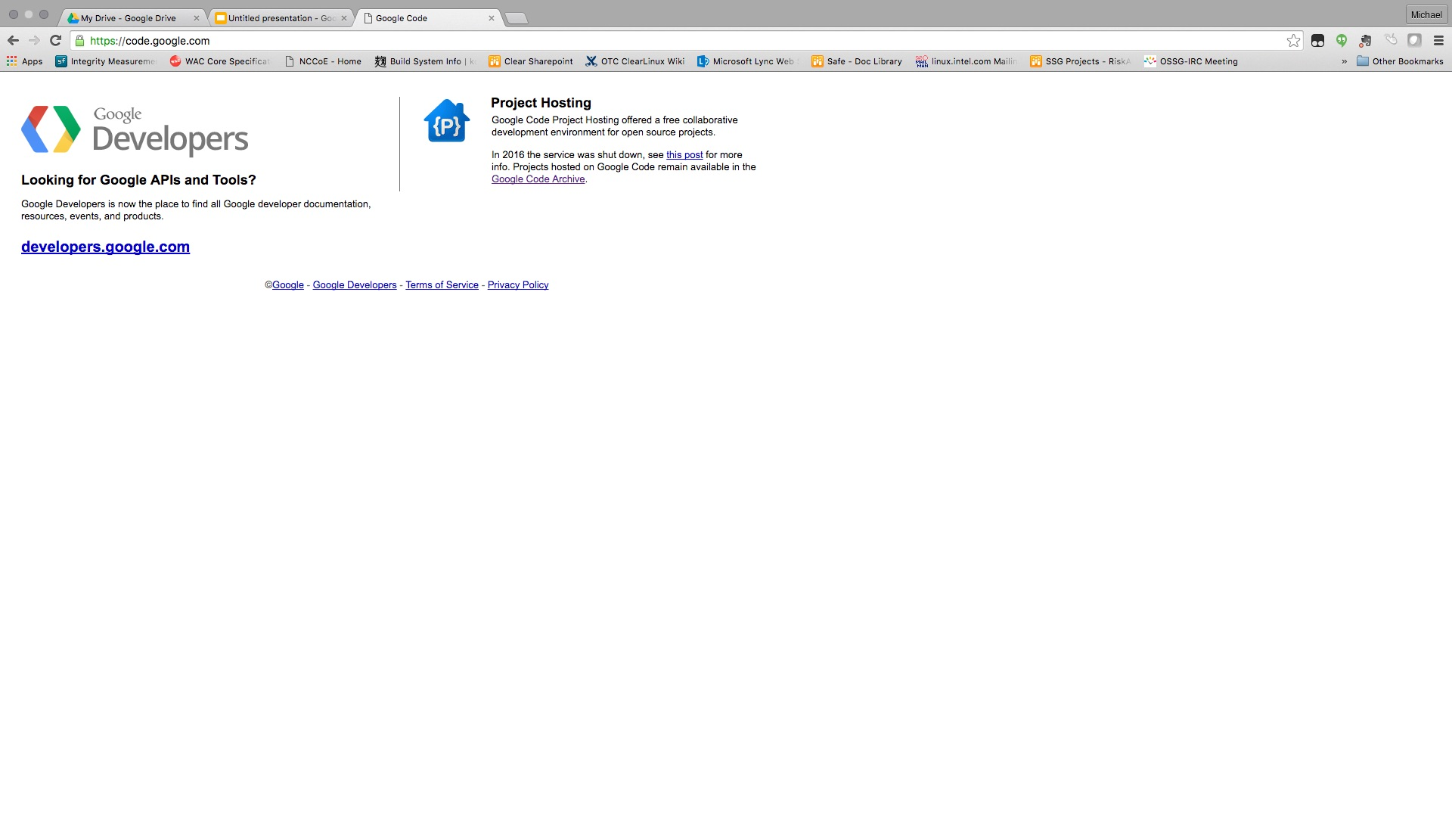
Shut down in January 2016
Notes:
In 2016 code.google.com was shut down. Many projects were moved elsewhere and are still maintained find those repositories, don't use anything here.

Slide 20
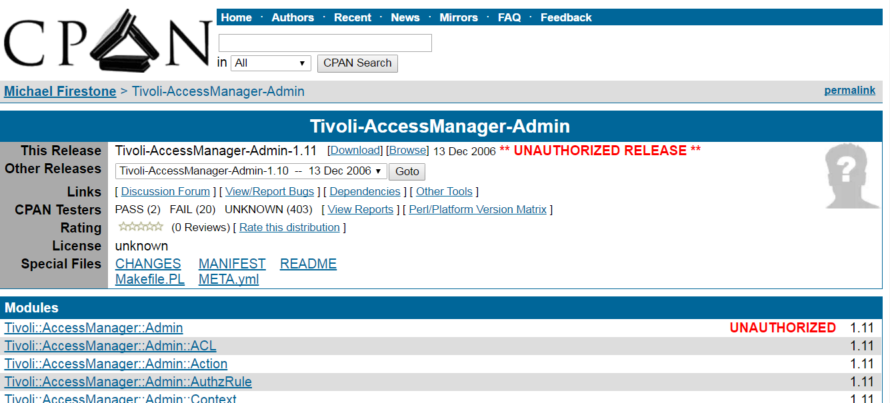
Does anyone really look to see what this means?
Notes:
ThisFrom CPAN:
A co-maintainer uploaded a new release, but because of an oversight wasn’t granted permission on one of the modules. This often happens with distributions that have a different release manager each cycle.
Someone without co-maintainer permissions forked the distribution and uploaded it.
An author makes a new release with a new namespace without realizing that namespace is taken by another author.

Slide 21

https://www.gograph.com/vector-clip-art/nope.html
Notes:
Provenance is everything. Where did it come from and can you trust it.

Slide 22
Would you trust this in your product
“opencsv was developed in a couple of hours”
“CryptoJS is a project that I enjoy and work on in my spare time, but unfortunately my 9-to-5 hasn't left me with as much free time as it used to. I'd still like to continue improving it in the future, but I can't say when that will be.”
http://opencsv.sourceforge.net/
https://code.google.com/archive/p/crypto-js/
Notes:
Two examples of developers that are telling you they don't necessarily do this for a living and maintenance will be less than optimal if at all. If a vulnerability is discovered can you trust that it would get fixed in a timely manner.. Probably better to look elsewhere. NOTE: The statement on opencsv would not be found without reading to the very end of the description to "Who maintains opencsv?"

Slide 23

Notes:
Don't hide away from finding these things out after the fact. Make it known this has huge implications.

Slide 24
“[This code is] slower and more subjective to side-channel attacks by nature”
http://www.literatecode.com/aes256
Notes:
Someone searching for a fast implementation of aes wanted to use this. The author tells you it was built to solve one use case and also goes on to tell you it is subject to attack vectors. I am not sure I would want to rest my reputation on adding this to a project.

Slide 25
“cJSON aims to be the dumbest possible parser that you can get your job done with. ”
https://github.com/kbranigan/cJSON/commit/730209a718cc9bada631cea136d13017752720f5
Notes:
When it comes to parsers the minute someone suggests writing their own just say NOPE. When you see key words like faster, lightweight, small footprint realize that something had to be given up to gain those attributes.

Slide 26
What would we like to see?
Notes:
We have now looked at some timeless real life examples of everything I hope to never see again. So on to look at some things that help us determine how well the community supports the open source you are choosing to put into a product.

Slide 27
Step 2: Check the contributors and community contributors & Activity
Notes:
Github has some great metrics that can really help you out.

Slide 28
Key questions about Contributors
Notes:
There are some key questions to ask yourself about contributors

Slide 29
How many active and significant contributors?
Is this code maintained or is it an archive?
Pull requests & checkins in the past year?
Are issues fixed and released on a regular basis?
Who signs off on code reviews?
Is there more than one maintainer?
Notes:
Active contributors are good but it the significant contributors that makes a big difference. When was the last time anything was checked in or when was the last release? How many outstanding pull requests? Are there discussions taking place? How many accepted pull requests?Does the project fix issues and issue new releases? It does no one any good if there is a fix checked in but no release. Do code reviews happen? Is it one person or a group effort? More eyes is better. Than of course is there more than one maintainer. More maintainers the better.

Slide 30
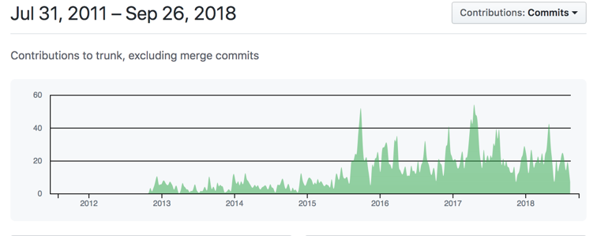
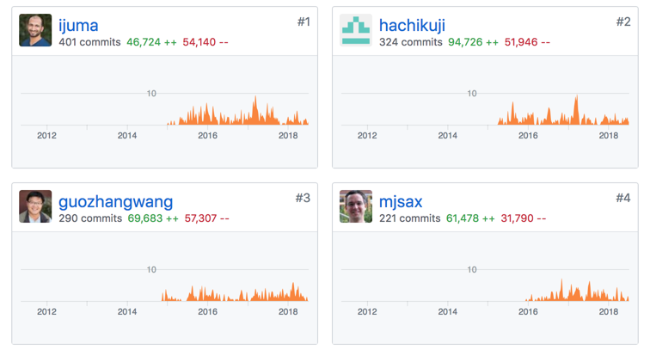
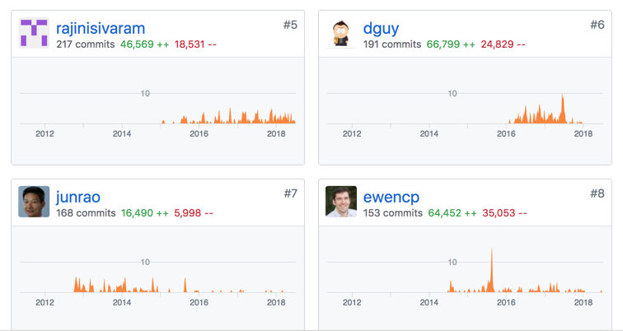
Good example: many active contributors
Notes:
So here’s an example of an active project. Apache Kafka. Many Active and significant contributors

Slide 31
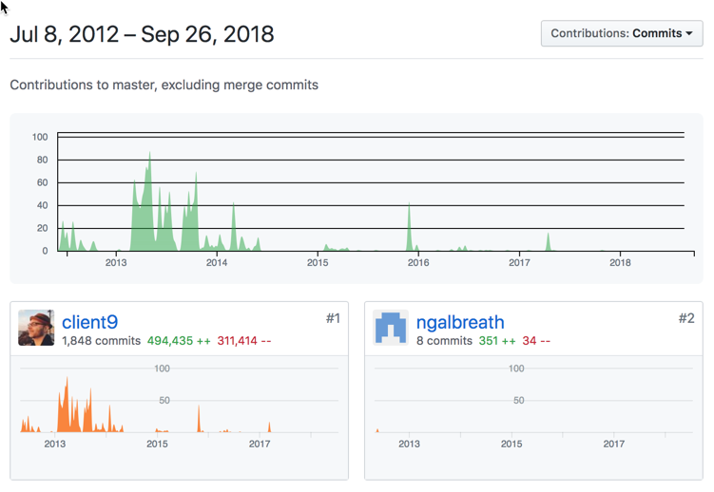
An example: One significant contributor and not recently active
Notes:
There were 18 contributors, 14 submitted significantly < 50 lines. Almost all of the code was written by one contributor and has had no activity since early 2017. Since it is a parser I would probably look somewhere else.

Slide 32
Step 3: Dependencies Dependencies Dependencies

Slide 33
How Dependent are your projects on other libraries

Slide 34
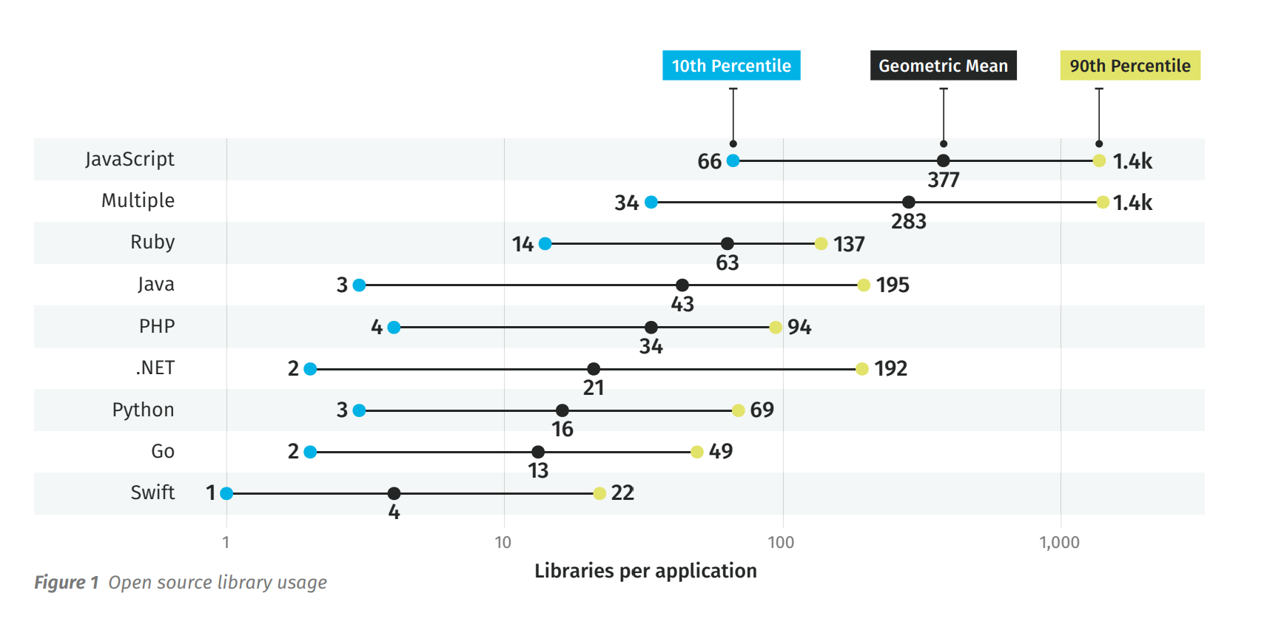
Source: Veracode State of Software Security

Slide 35
Good packages do not guarantee good dependencies
Notes:
Another thing that comes up a lot is that you’ve chosen a great, well-supported framework so you think for sure everything they’ve chosen is also going to be great and well-supported. I also wish this were true, but it’s not.

Slide 36
Why?
Upstream projects do not use the same criteria for inclusion as Products should
It is possible for a package to depend on code that has vulnerabilities
Understand your dependencies and the additional risk it brings. Allocate time to work on the issues
Notes:
Why is this an issue? Remember that when you carefully vette an OSS component that you really need to be aware of what it depends on. Because when you bring that component into your project you will also be bringing anything it depends on too, good or bad.

Slide 37
Repositories are not created equal
Npm (node.js), PyPi (python), ruby gems (ruby), CPAN (perl), etc. are not curated
Notes:
Anybody can create and check in to projects. Just because you have valid credentials to check in to a project does not mean you're a good guy.
Python Security - https://github.com/PyCQA/bandit
npm Security - https://github.com/i0natan/nodebestpractices#6-security-best-practices

Slide 38
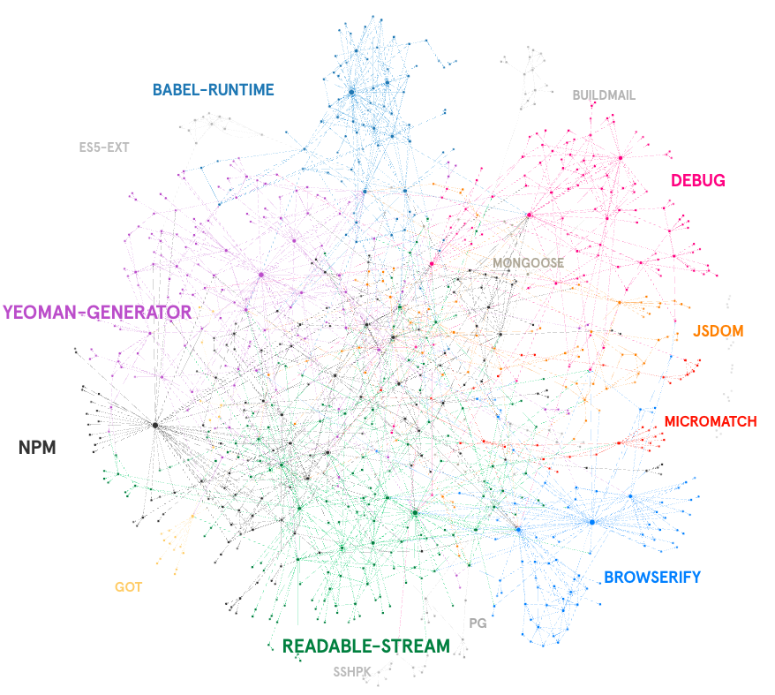
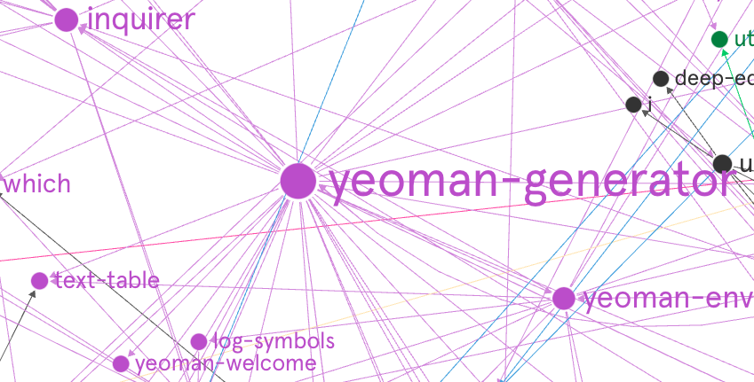
Package managers don’t always imply high quality
I wonder what happens when you remove a module?
Oh wait!! that already happened
Notes:
As seen in this chart of the npm tree of the first 4 levels of dependency shows that if you were to slip one module in there or even take one away you could wreak havoc
Oh wait!! that already happened

Slide 39
“How removing 11 lines of code nearly broke the internet”
We all heard about this one
Notes:
A related story about this is the “11 lines of code that nearly broke the Internet”
This is kind of a sad story about a guy whose open source project had the same name as something someone else had trademarked. When he refused to change the name of his already well-established project, the lawers got npm to give them rights to the name and thus trounced his work.
Upset, he pulled the rest of his code in protest, including software that was used by a bunch of big names, including Facebook and Netflix. All of a sudden, big popular projects were broken, and people were freaking out. Npm re-published his removed code and gave it to a new owner.
There’s two things you should worry about here: one, if there’s a trademark dispute on a name, code you’re using may suddenly be completely different code. And similarly, if a project becomes popular, it could be handed over to a new owner without consent or any warning. If you don’t verify the code you’re getting, you could seriously be getting anything, at any time, and not just if the developer decided to become malicious.

Slide 40
event-stream incident
This attack started out as a social engineering attack. The attacker, posing as a maintainer, took over maintainership of the event-stream module.
https://blog.npmjs.org/post/180565383195/details-about-the-event-stream-incident
Notes:
On the morning of November 26th, npm’s security team was notified of a malicious package that had made its way into event-stream, a popular npm package. After triaging the malware, npm Security responded by removing flatmap-stream and event-stream@3.3.6 from the Registry and taking ownership of the event-stream package to prevent further abuse.
Now that it has happened once do you think it can happen again

Slide 41
is-promise
And Yet Another April 2020
https://www.zdnet.com/article/another-one-line-npm-package-breaks-the-javascript-ecosystem/
Notes:
Despite being just two lines of code that perform a basic check, the is-promise library is one of today's most popular JavaScript npm packages (libraries). According to GitHub, the library is part of more than 3.4 million projects and used as a dependency by 766 other JavaScript libraries.
Over the weekend, the is-promised library was updated to receive support to work as an ES module -- the standardized module system used by the JavaScript language.
However, the is-promise v.2.2.0 release didn't adhere to the proper ES module standards. As soon as the update was out, projects that used is-promise inside their build chain started failing due to the improper ES module support [1, 2, 3, 4, 5, 6, 7, 8, 9, 10].
The effect of the error was felt immediately, and impacted from closed-source JavaScript codebases to some of the JavaScript ecosystem's biggest projects.
This included Facebook's Create React App (the standard template for creating React apps), Google's Angular framework, Google's Firebase-tools, Amazon's AWS Serverless CLI, Nuxt.js, AVA, and more.

Slide 42
Colors and Faker
Wait there is more!!!!
https://www.bleepingcomputer.com/news/security/dev-corrupts-npm-libs-colors-and-faker-breaking-thousands-of-apps/
Notes:
Users of popular open-source libraries 'colors' and 'faker' were left stunned after they saw their applications, using these libraries, printing gibberish data and breaking.
Some surmised if the NPM libraries had been compromised, but it turns out there's much more to the story.
The developer of these libraries intentionally introduced an infinite loop that bricked thousands of projects that depend on 'colors' and 'faker.'
The colors library receives over 20 million weekly downloads on npm alone and has almost 19,000 projects relying on it. Whereas, faker receives over 2.8 million weekly downloads on npm, and has over 2,500 dependents.
"Apparently the author of 'colors.js' is angry for not being payed [sic]... So he decided to print the American flag each time his library is loaded... WTF," tweeted one user.
Some dubbed this an instance of "yet another OSS developer going rogue," whereas InfoSec expert VessOnSecurity called the action "irresponsible," stating:
"If you have problems with business using your free code for free, don't publish free code. By sabotaging your own widely used stuff, you hurt not only big business but anyone using it. This trains people not to update, 'coz stuff might break."

Slide 43
Step 4: Check how they handle vulnerabilities & security issues

Slide 44
Key Questions about Security Issues
Is there a clear way to report security vulnerabilities?
Is there evidence that vulnerabilities are fixed in a timely manner?
Is there any explanation of what happens when a security issue is reported?
Notes:
An ideal procedure should involve a way to keep the vulnerability secret until a fix is found. Typical good solutions: send email to a special security mailing list. Bug tracker with special “security” flag. If there’s no way to report security issues specifically, assume they have not thought about it (and this is a bad sign).

Slide 45
Why is this important?
???

Slide 46
No known vulnerabilities does not equal security
Notes:
Just because there are no known vulnerabilities does not mean that it is safe to use. In fact it means quite the opposite. You should probably scrutinize it even more because it more than likely means no one is really looking at it. It does not matter how well looked at it will have vulnerabilities and you need to be prepared to remediate them.

Slide 47
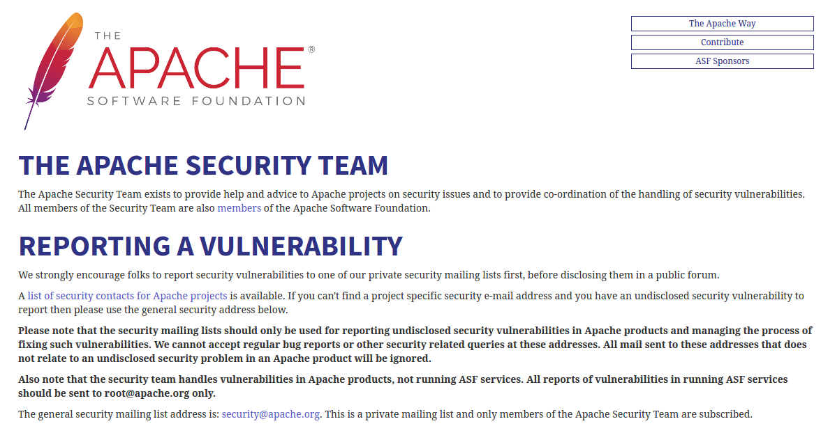
Great Example:
https://www.apache.org/security/
Notes:
One of the best examples is Apache. They have a very clear vulnerability process that we know from experience that they follow, and it applies to all the active projects under the Apache banner.

Slide 48
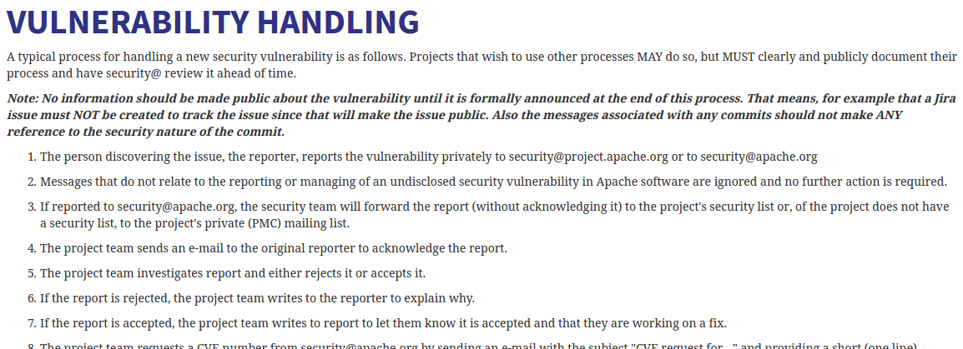
Written policy
https://www.apache.org/security/committers.html
Notes:
They even go one step further to let people know what to expect when they report a bug, so you can tell if they’re handling things by their process pretty easily.

Slide 49
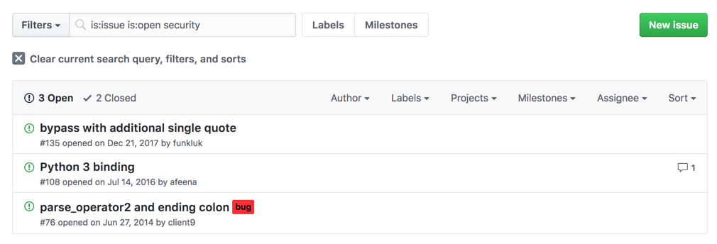
Look for unfixed security bugs
Notes:
Unfixed security bugs will come back to haunt you someday sometime. Better to know up front and choose something totally different.

Slide 50
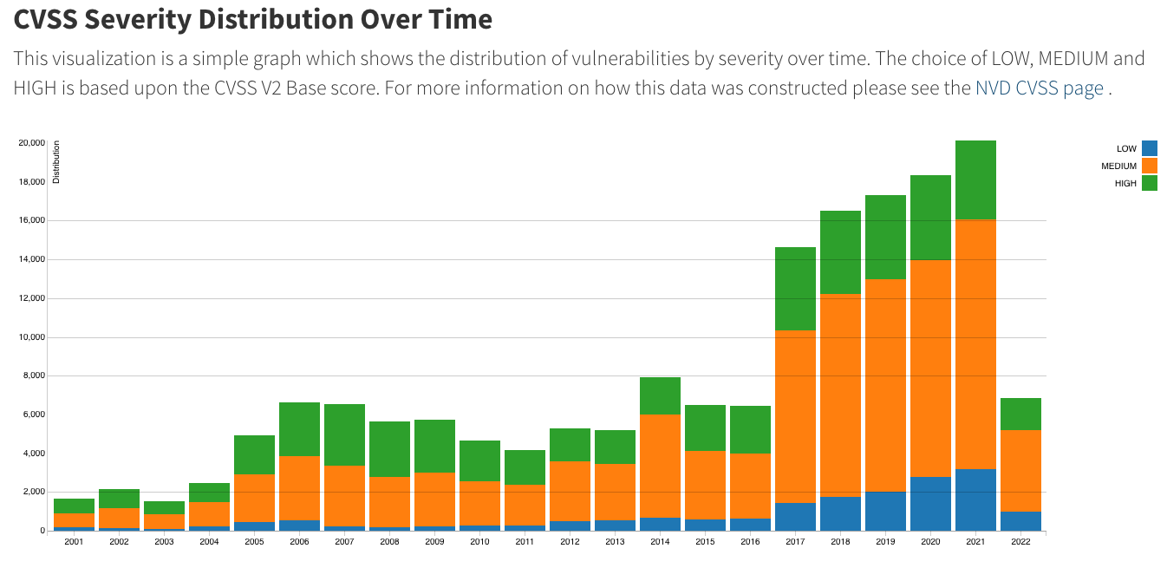
It seems that we are getting worse at security
https://nvd.nist.gov/general/visualizations/vulnerability-visualizations/cvss-severity-distribution-over-time
Notes:
Severity distribution over time.
https://nvd.nist.gov/general/visualizations/vulnerability-visualizations/cvss-severity-distribution-over-time
https://www.cvedetails.com/browse-by-date.php

Slide 51
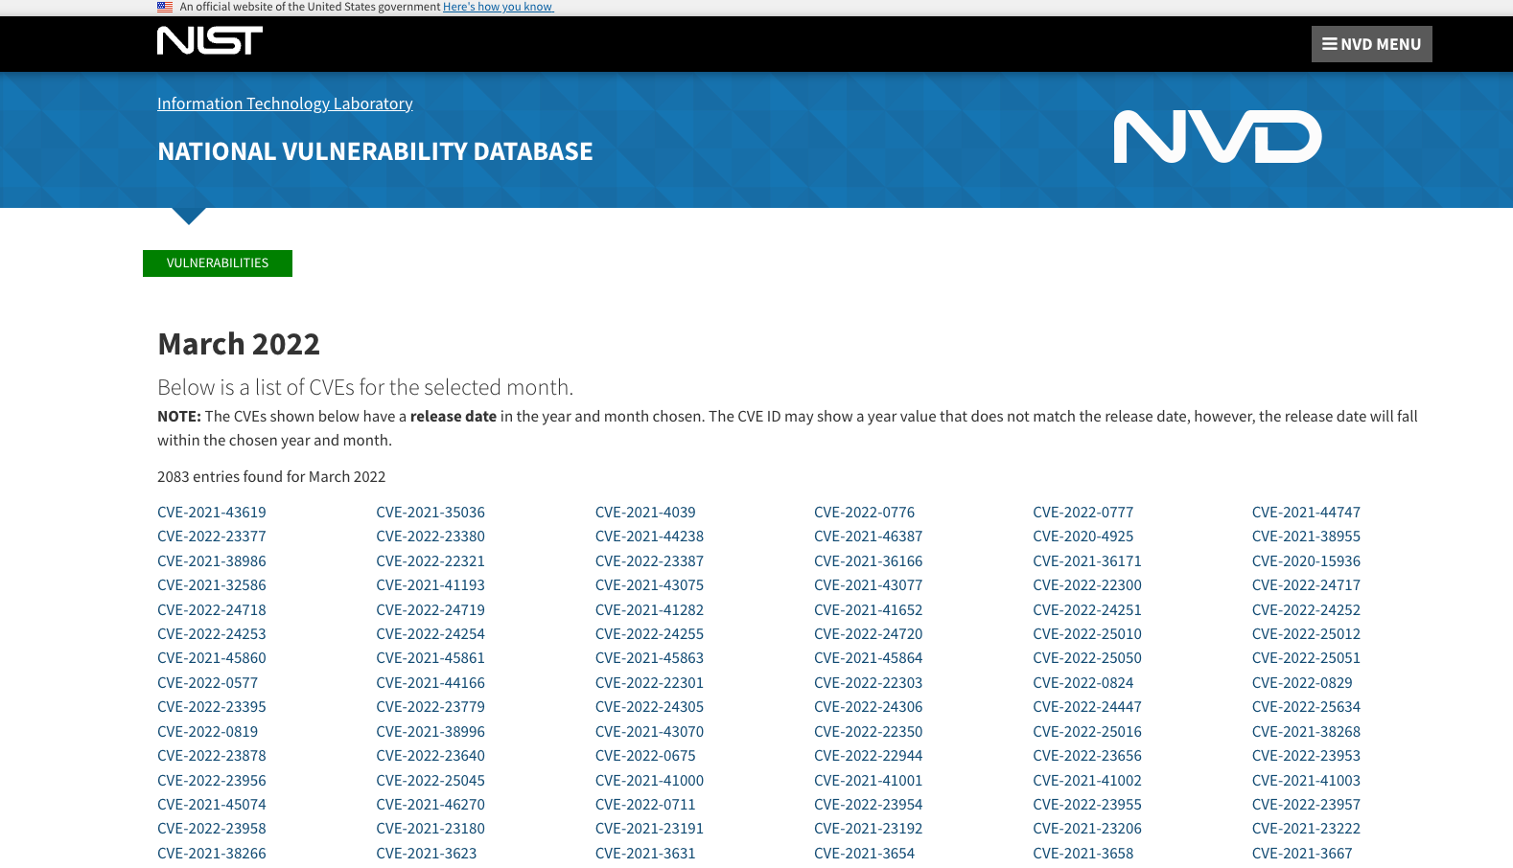
March 2022 alone 2083 new Vulnerabilities
https://nvd.nist.gov/vuln/full-listing/2022/3
Notes:
At the time of slide creation 2083 vulnerabilities just for the month March 2022.

Slide 52
Good security reporting does not guarantee action
Notes:
And one last one to note is that good security reporting doesn’t actually guarantee good action. You’re probably not going to know which companies and groups have good reputations, and that’s why you rely on the expertise of the open source group at Intel, but I want you to be aware that this is an issue that could come up.

Slide 53
Why? These are a few of the most common reasons
CVEs (Common Vulnerabilities and Exposures) aren’t easy to file,
This can be a sign of a lack of security expertise
many times no one is looking

Slide 54
Sometimes issues are actively rejected or hidden
How Project Teams react to known vulnerabilities will help you to evaluate their security processes. many times no one is looking

Slide 55
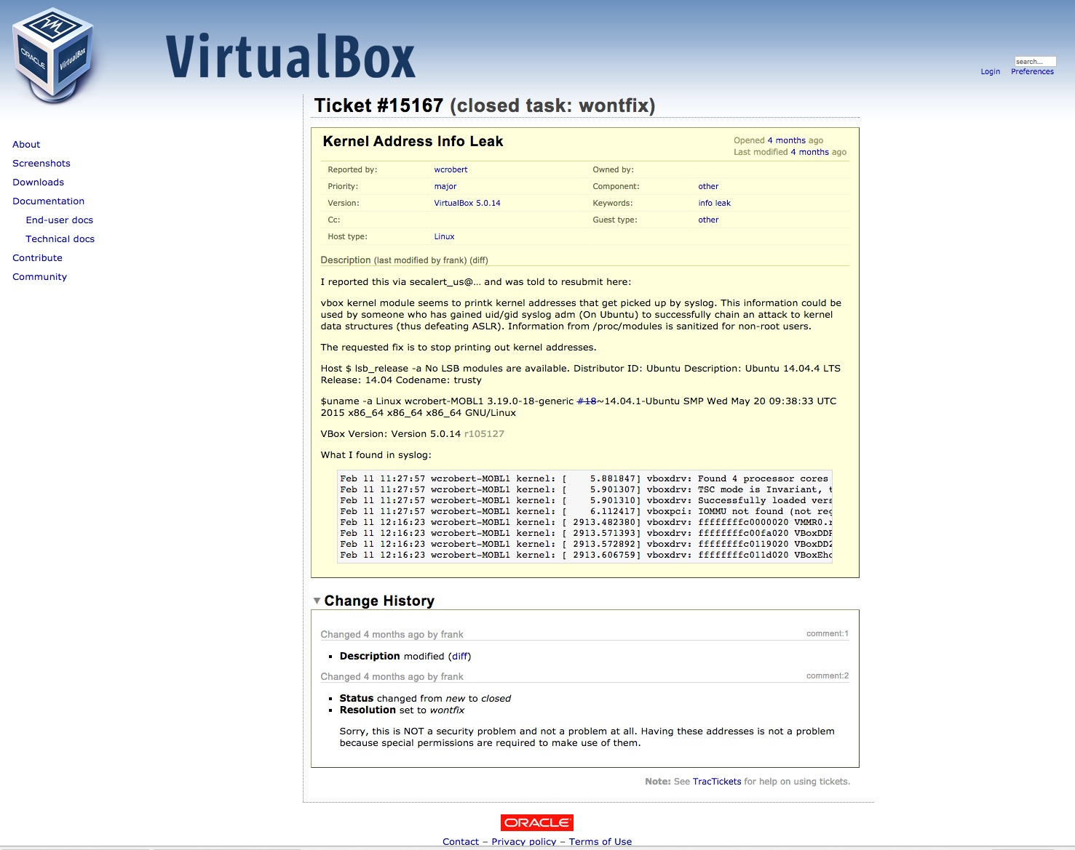
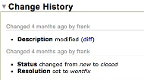
Notes:
Here’s one that’s come up recently. You probably can’t read this on the screen, but this is a closed bug reported by one of our security team members, Bill Roberts. It is just an innocuous little leakage of kernel space address.

Slide 56
This turned out to be untrue, and a CVE was actually issued
Notes:
Zooming in so you can see it, you can see that the person who triaged this bug said it wasn’t an issue. But thanks to the work of our intern, John Anderson, who provided additional information and a proof of concept, they’ve now acknowledged this as a real issue and they issued a public vulnerability number for it and getting it fixed. But if he hadn’t persisted, this security issue could have still been an issue in virtualbox indefinitely!
NOTE: There is always someone willing to spend the time to create an exploit. Whether for money or fame someone somewhere will do it just because it is there.

Slide 57
Step 5:
Is there any testing?
What about the test suite
Notes:
Another thing you can do if you’re just not sure about a project is to take a look at the test suite.

Slide 58
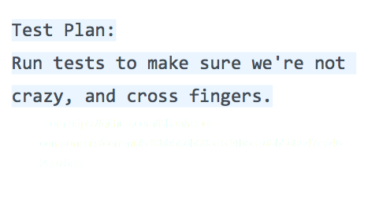
Is there a Test suite
Notes:
So what do good and bad test suites look like? I was going to show some examples, but it got unreadable pretty quickly, so let’s just talk qualities. [Speaker will summarize from slide]

Slide 59
Key Questions About Test Suites
Testing isn’t the only thing we take into account, but it can be used as a rule of thumb if you don’t know security and want to guess at what might be a good library.
Does this test suite cover bad behavior?
How comprehensive is this test suite?
Notes:
As before, here’s some key questions for folk who aren’t sure what a “good” test suite looks like. We’re looking for a good variety of tests covering good and bad behavior, and test suites are really important for things that parse user input.

Slide 60
Key Questions about Test Suites (cont)
Do all tests pass?
Is there continuous integration for tests?
Testing is especially important for libraries that handle user input: parsers, input validation libraries, etc. A poor test suite doesn’t guarantee a bad component, but a good suite often implies a better choice.
Notes:
As before, here’s some key questions for folk who aren’t sure what a “good” test suite looks like. We’re looking for a good variety of tests covering good and bad behavior, and test suites are really important for things that parse user input.

Slide 61
Step 6: Be aware
of
assumptions
Notes:
And finally, I want to take a moment to make sure you’re all aware of the type of assumptions we see that result in us making poor choices.

Slide 62
Popularity does not equal security
Notes:
First off, popularity doesn’t equal security. Open source proponents like to talk about many eyes making all bugs shallow, but alas, many untrained eyes don’t mean you’re not going to find finicky security bugs.

Slide 63
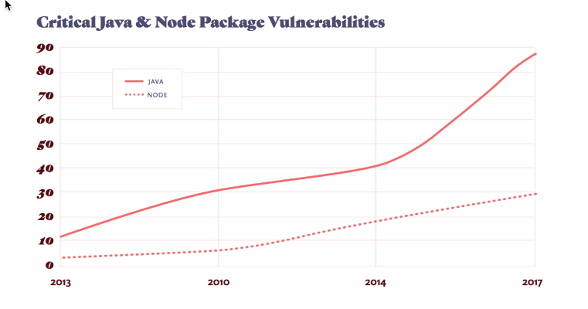
“90% of tested organizations use vulnerable dependencies."
- https://snyk.io/

Slide 64
Bringing it all together
Notes:
Lot's of information presented very quickly. I will make this presentation available to all including the presenter notes. Let's take a look at what you should take away at the least.

Slide 65
Key Takeaways
Check the License and the repository
Take a look (Are there red Flags?) Really Read it
Check for the number of contributors & activity
Be aware of your dependencies
Does the project handle security issues
Look for a test suite (make sure it does something)
Be aware Trust nothing
Notes:
So here’s the list all on one slide. It might take some time the first few times you run through this list. BUT if you do this every time and vette everything with a some amount of scrutiny you will lower the projects overall risk exposure.

Slide 67
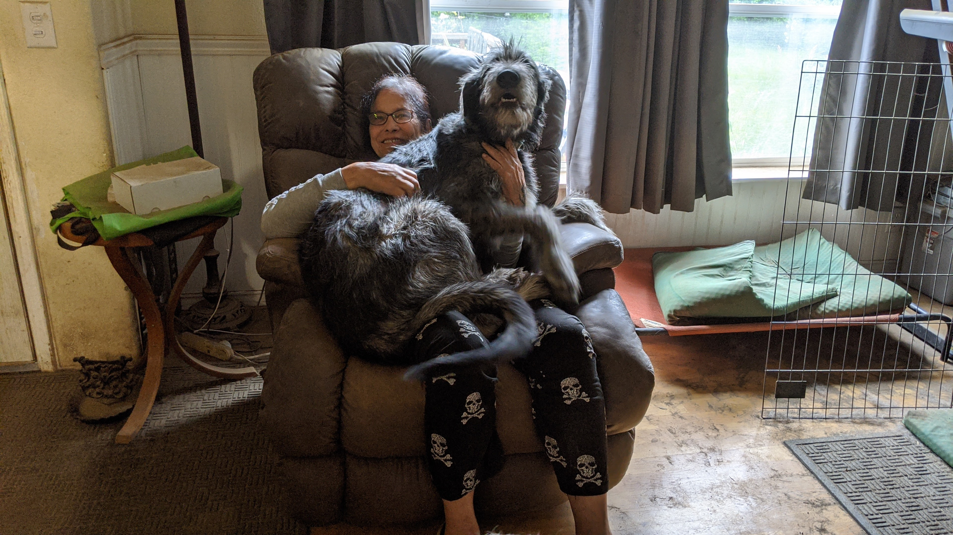
Open Source is Free Like Getting a “Free Puppy”

Slide 68

COMING SOON
SECUREWORLD
There are no silver bullets and the werewolves will eat you, there is no one tool to manage all risk
Fall of 2022
https://www.sonypictures.com/movies/underworld

Slide 69
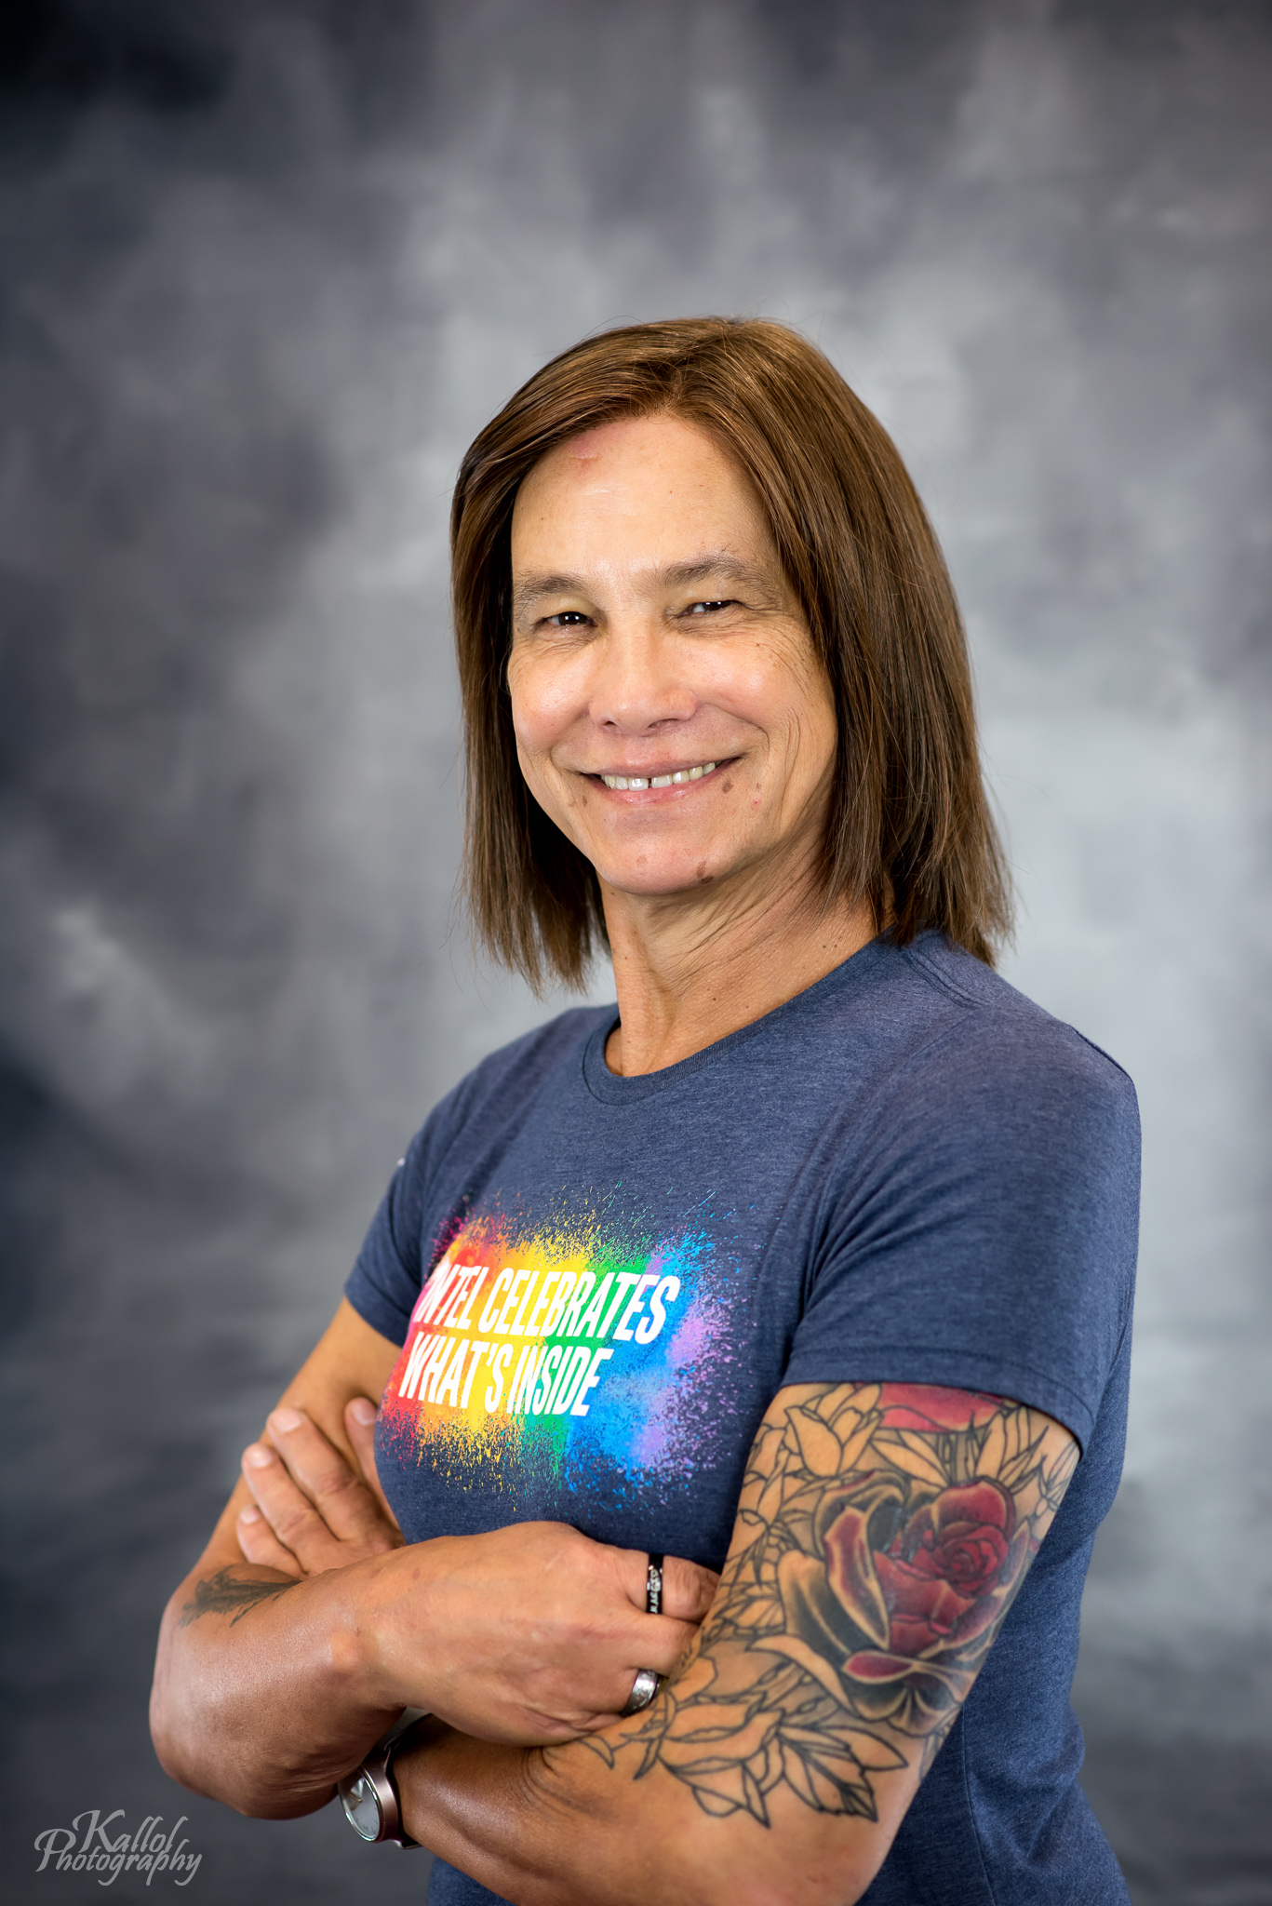
Please Support https://www.transtechsocial.org/
LinkedIn: https://www.linkedin.com/in/mikide/
Twitter: @theDawgCr8
GitHub: https://github.com/sec-princess
Email: miki.demeter@intel.com
Intel Credits: Terri Oda, Tiberius Heflin, Bill Roberts, John Anderson, Ryan Ware
Notes:
LinkedIn: https://www.linkedin.com/in/mikide/
Twitter: @theDawgCr8
GitHub: https://github.com/sec-princess
Email: sec-princess@unroutable.me

Slide 70

QUESTIONS?

Slide 71
Thank you!

Slide 72
Title
SubTitle

Slide 73
header
Bullet
Bullet
Bullet
Bullet
Bullet
Bullet

Slide 74
header
Bullet
Bullet
Bullet
Bullet
Bullet
Bullet

Slide 75
header
Bullet
Bullet
Bullet
Bullet
Bullet
Bullet

Slide 76
header
Bullet
Bullet
Bullet
Bullet
Bullet
Bullet

Slide 77
header
Bullet
Bullet
Bullet
Bullet
Bullet
Bullet

Slide 78
header
Bullet
Bullet
Bullet

Slide 79
header
Bullet
Bullet
Bullet

Slide 80
header
Bullet
Bullet
Bullet

Slide 81
header
Bullet
Bullet
Bullet

Slide 82
header
Bullet
Bullet
Bullet

